Slide 1


Electric Circuits
Twelfth Edition, Global Edition
Chapter 2 – Part 3
Circuit Elements
© 2024 Pearson Education Ltd. All Rights Reserved.
Notes:
If this PowerPoint presentation contains mathematical equations, you may need to check that your computer has the following installed:
1) Math Type Plugin
2) Math Player (free versions available)
3) NVDA Reader (free versions available)

Slide 2
Chapter 2 – Circuit Elements (1 of 9)
Review resistors:
Ohm’s Law
K C L
K V L
Solving circuits
Let’s do some examples of how to solve circuits containing independent sources, dependent sources and resistors.

Slide 3

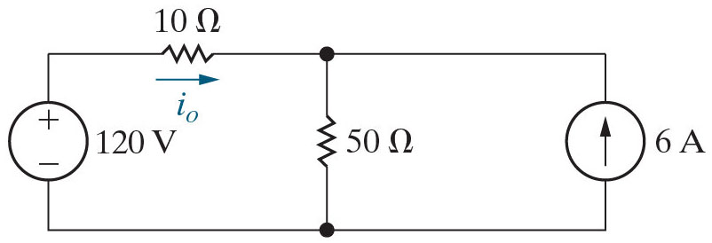
Chapter 2 – Circuit Elements (2 of 9)
Example:
Find the current
and show that the power in this circuit
balances.
Begin by labeling all of the unknown voltages and currents and all of the nodes on the copy of this circuit on the next slide. Figure out how many unknowns you have. Then use Ohm’s Law, K C L, and K V L to write the independent equations you need.

Slide 4
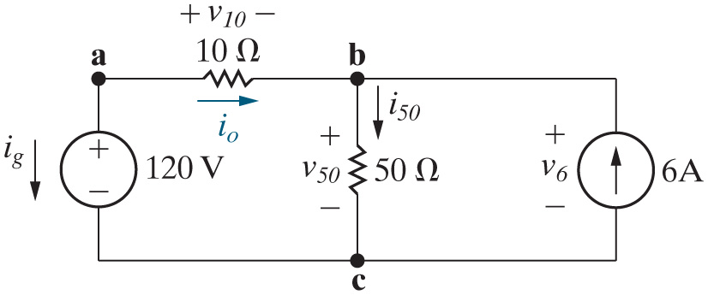











Chapter 2 – Circuit Elements (3 of 9)
Example (continued)
3 unknown voltages and
3 unknown currents
So we need 6 equations
Ohm’s Law:
K C L:
K V L:
Solve K C L at b for
Substitute Ohm’s Law equations in K V L left:
Substitute for
and solve:

Slide 5
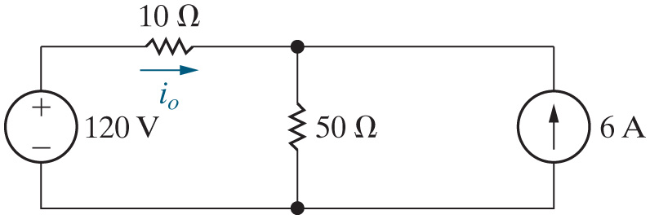


Chapter 2 – Circuit Elements (4 of 9)
Before we start calculating the power, let’s try to predict which elements will be supplying power.
A. Just the resistors
B. Just the sources
C. One resistor and one source
D. We need more information

Slide 6
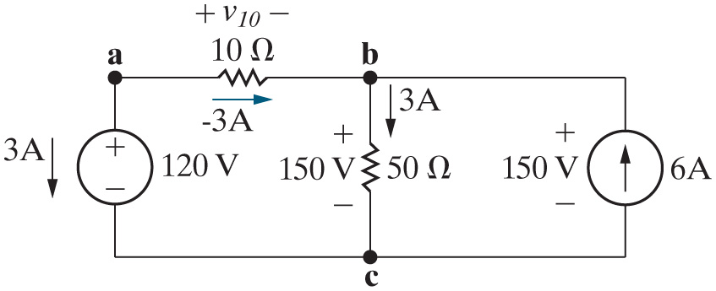




Chapter 2 – Circuit Elements (5 of 9)
Example (continued)
Power balance:
Total power is 360 + 90 + 450 − 900 = 0 (check!)

Slide 7
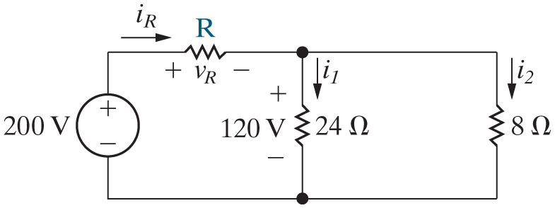


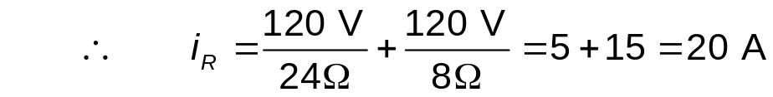
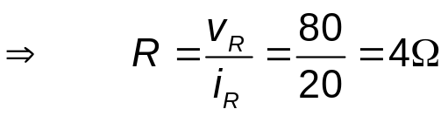
Chapter 2 – Circuit Elements (6 of 9)
Example:
Find R.
To find R we need to find the voltage drop across R and the current through R:
K V L left:
K C L top:
K V L right:

Slide 8
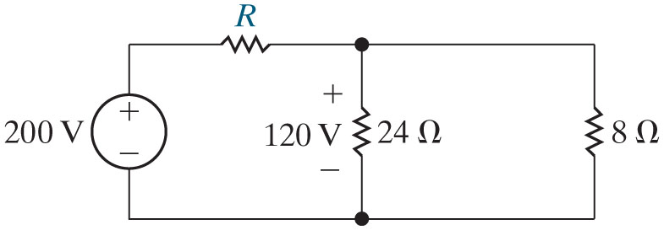
Chapter 2 – Circuit Elements (7 of 9)
Let’s see if we can predict which elements will be supplying power in the circuit below.
A. Just the resistors
B. Just the source
C. The source and one resistor
D. We need more information

Slide 9
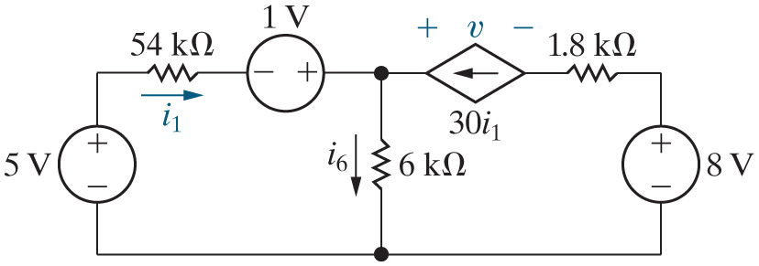



Chapter 2 – Circuit Elements (8 of 9)
Example:
Find
v, and show
that the power
balances.
K V L left:
K C L top:
K V L right:
Notes:
Long Description:
Forward arrow, v equals OpenParenthesis 6000 CloseParenthesis multiplied by OpenParenthesis 31 CloseParenthesis multiplied by OpenParenthesis 25 mu CloseParenthesis minus 8 plus OpenParenthesis 1800 CloseParenthesis multiplied by OpenParenthesis 30 CloseParenthesis multiplied by OpenParenthesis 25 mu CloseParenthesis equals negative 2 Volts.

Slide 10
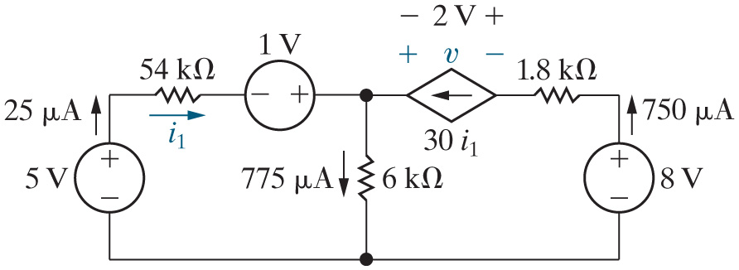







Chapter 2 – Circuit Elements (9 of 9)
Example:(continued)
Power balance:
The sum of the power is
− 120 + 1500 + 33.75 + 1012.5 − 25 − 6000 + 3603.75 = 0!

Slide 11

Copyright
This work is protected by United Kingdom copyright laws and is provided solely for the use of instructors in teaching their courses and assessing student learning. Dissemination or sale of any part of this work (including on the World Wide Web) will destroy the integrity of the work and is not permitted. The work and materials from it should never be made available to students except by instructors using the accompanying text in their classes. All recipients of this work are expected to abide by these restrictions and to honor the intended pedagogical purposes and the needs of other instructors who rely on these materials.

